Slide 1
CS 211 Computer Architecture Lecture 29: RISC-V: Datapath Design Part 5 Datapath for jump instructions, Control Logic
Ravi Mittal
ravi.mittal@iitgoa.ac.in
Indian Institute of Technology, Goa

Slide 2
Acknowledgements
Class Presentation, RISC-V CPU Control, Pipelinging, CS61C, Great Ideas in Computer Architecture, University of Berkeley, Morgan Rae Rechenberg
Class Presentation, CS61C, Machine Structures, University of Berkeley, Dan Garcia and Miki Lustig, 2019
Class Presentation, CS61C, Introduction to Assembly Language and RISC-V Instruction Set Architecture, University of Berkeley, Prof Krste Asanović & Randy H. Katz. http://inst.eecs.Berkeley.edu/~cs61c
Computer Organization and Design, The Hardware Software Interface, RISC-V edition, Patterson and Hennessey
Digital Design and Computer Architecture: RISC-V Edition, Harris & Harris Elsevier – Presentation.

Slide 3
RISC-V: So far we have studied
Arithmetic operations: add, sub, addi,
How to bring data from memory to register and vice versa?
lw, sw, lb, sb, lbu
Bit-by-bit logical instructions
and, or, xor, andi, ori, xori
Logical Shift instructions
sll, srl, sra, slli, srli, srai
Generating Constants
Branching Instructions: beq, bne, blt/bltu, bge/bgeu
Jumping instruction: j
Assembly level program for: if, if/else,
Function Calls
Basics, Input arguments and Return Value
while, for loops
The Stack
Basics, How functions use a stack
Stack use in non-leaf function calls
Recursive Functions
Floating Point Numbers
Instruction Formats
Machine Instructions
Microarchitecture
Combinational and Sequential logic
Clock, Registers, Muxes, Adder, Subtractor, Comparator, Buses, Register file, Idealized Memory
Timing considerations
Maximum frequency
Single Cycle Vs Multicycle vs Pipeline
Datapath design for R-type, and I-type Instructions: add, sub, addi, lw, sw, branch instructions

Slide 4
Last Class

Slide 5
Adding Branches
Comparison (R[rs1] == R[rs2],
Addition (PC = PC + Imm) or PC= PC+4
BEQ RS1, RS2, Label
+4
Add
Add
DataD
Reg[rs1]
1
1
Inst[11:7]
AddrD
0
wb
PC
addr
1
0
pc
addr
Inst[19:15]
DataA
alu
DataR
inst
pc+4
inst
AddrA
Branch
Comp
0
+
addr
mem
Inst[24:20]
AddrB
DataB
ALU
clk
0
DataW
IMEM
IMEM
Reg [ ]
1
DMEM
Inst [31:7]
clk
Reg[rs2]
clk
Imm.
Gen
Imm[31:0]
PCSel= taken/not taken
Inst[31:0]
ImmSel
=B
RegWEn =0
BrUn
BrLT
Bsel
=1
ALUSel
=Add
MemRW
=Read
WBSel =*
(*=Don’t care)
BrEq
Asel
=1
Control logic

Slide 6
In this class we will study
Datapath for Jump instruction
Datapath for Upper Immediate
Datapath for jal instruction
Datapath for lui and auipc
Design of Control logic

Slide 7
Datapath for Jumps

Slide 8
Adding jalr (I-Format)
31
20
19
15
14
12
11
7
6
0
imm[11:0]
rs1
func3
rd
opcode
12
5
3
5
7
offset[11:0]
base
0
dest
JALR
jalr rd, rs, immediate
Two changes to the state
Writes PC+4 to rd (return address)
Sets PC = rs + immediate
Uses same immediates as in arithmetic and loads
CS61C Prof Dan Garcia and Miki Lustig, Univ of California, Berkeley

Slide 9
Datapath with jalr
CS61C Prof Dan Garcia and Miki Lustig, Univ of California, Berkeley
+4
Add
Add
pc+4
2
DataD
Reg[rs1]
1
1
Inst[11:7]
AddrD
0
wb
PC
addr
1
0
addr
Inst[19:15]
DataA
alu
DataR
inst
pc+4
inst
AddrA
Branch
Comp
0
+
addr
mem
Inst[24:20]
AddrB
DataB
ALU
clk
0
DataW
IMEM
IMEM
Reg [ ]
1
DMEM
Inst [31:20]
clk
Reg[rs2]
clk
Imm.
Gen
Imm[31:0]
PCSel
Inst[31:0]
ImmSel
RegWEn
BrUn
BrLT
Bsel
ALUSel
MemRW
WBSel
Control logic
Asel
Control logic
BrEq
31
20
19
15
14
12
11
7
6
0
imm[11:0]
rs1
func3
rd
opcode
12
5
3
5
7
offset[11:0]
base
0
dest
JALR

Slide 10
Adding jalr (R[rd] = PC+4; PC = R[rs1] + imm)
+4
Add
Add
pc+4
2
DataD
Reg[rs1]
1
1
Inst[11:7]
AddrD
0
wb
PC
addr
1
0
pc
addr
Inst[19:15]
DataA
alu
DataR
inst
pc+4
inst
AddrA
Branch
Comp
0
+
addr
mem
Inst[24:20]
AddrB
DataB
ALU
clk
0
DataW
IMEM
IMEM
Reg [ ]
1
DMEM
Inst [31:7]
clk
Reg[rs2]
clk
Imm.
Gen
Imm[31:0]
PCSel =taken
Inst[31:0]
ImmSel
=I
RegWEn =1
BrUn
=*
BrLT
=*
Bsel
=1
ALUSel
=Add
MemRW
=Read
WBSel =2
Control logic
Asel
=0
Control logic
BrEq=*
CS61C Prof Dan Garcia and Miki Lustig, Univ of California, Berkeley

Slide 11
Adding jal
31
30
21
20
19
12
11
7
6
0
imm[20]
imm[10:1]
imm[11]
imm[19:12]
rd
opcode
1
10
1
8
5
7
offset[20:1]
dest
JAL
2 operands:
rd: destination register
imm_{20,10:1,11,19:12}: 20 bits (20:1) of a 21-bit immediate
It does the following:
saves return address: PC + 4 → register rd
PC relative jump: PC + sign extended (2*immediate) → PC
Target somewhere in the range of -2²⁰ to 2²⁰ relative to PC
In words, the offset is sign-extended, multiplied by 2, and added to the value of the PC (address of jal instruction)
CS61C Prof Dan Garcia and Miki Lustig, Univ of California, Berkeley

Slide 12
Datapath with jalr
+4
Add
Add
pc+4
2
DataD
Reg[rs1]
1
1
Inst[11:7]
AddrD
0
wb
PC
addr
1
0
addr
Inst[19:15]
DataA
alu
DataR
inst
pc+4
inst
AddrA
Branch
Comp
0
+
addr
mem
Inst[24:20]
AddrB
DataB
ALU
clk
0
DataW
IMEM
IMEM
Reg [ ]
1
DMEM
Inst [31:20]
clk
Reg[rs2]
clk
Imm.
Gen
Imm[31:0]
PCSel
Inst[31:0]
ImmSel
RegWEn
BrUn
BrLT
Bsel
ALUSel
MemRW
WBSel
Control logic
Asel
Control logic
BrEq
CS61C Prof Dan Garcia and Miki Lustig, Univ of California, Berkeley

Slide 13
Adding jal (R[rd] = PC+4; PC = PC + {imm,1b’0})
+4
Add
Add
pc+4
2
DataD
Reg[rs1]
1
1
Inst[11:7]
AddrD
0
wb
PC
addr
1
0
addr
Inst[19:15]
DataA
alu
DataR
inst
pc+4
inst
AddrA
Branch
Comp
0
+
addr
mem
Inst[24:20]
AddrB
DataB
ALU
clk
0
DataW
IMEM
IMEM
Reg [ ]
1
DMEM
Inst [31:7]
clk
Reg[rs2]
clk
Imm.
Gen
Imm[31:0]
PCSel
=taken
Inst[31:0]
ImmSel =J
RegWEn =1
BrUn
=*
BrLT =*
Bsel=1
ALUSel =add
MemRW
=Read
WBSel =2
Control logic
Asel=1
Control logic
BrEq=*
CS61C Prof Dan Garcia and Miki Lustig, Univ of California, Berkeley

Slide 14
Datapath for Upper Immediate

Slide 15
U-Format for Upper Immediate Instructions
31
12
11
7
6
0
imm[31:12]
rd
opcode
20
5
7
U-immediate[31:12]
dest
LUI
U-immediate[31:12]
dest
AUIPC
Has 20-bit immediate in upper 20 bits of 32-bit instruction word
One destination register, rd
Used for two instructions
LUI – Load Upper Immediate to register rd
AUIPC – Add Upper Immediate to PC and load to register rd
CS61C Prof Dan Garcia and Miki Lustig, Univ of California, Berkeley

Slide 16
Implementing lui (R[rd] = {imm, 12’b0})
+4
Add
Add
wb
pc+4
2
DataD
Reg[rs1]
1
1
Inst[11:7]
AddrD
0
wb
PC
addr
1
0
addr
Inst[19:15]
DataA
alu
DataR
inst
pc+4
inst
AddrA
Branch
Comp
0
+
addr
mem
Inst[24:20]
AddrB
DataB
ALU
clk
0
DataW
IMEM
IMEM
Reg [ ]
1
DMEM
Inst [31:7]
clk
Reg[rs2]
clk
Imm.
Gen
Imm[31:0]
PCSel
=pc+4
Inst[31:0]
ImmSel =U
RegWEn =1
BrUn
=*
BrLT =*
Bsel=1
ALUSel =B
MemRW
=Read
WBSel =1
Control logic
Asel=*
Control logic
BrEq=*
CS61C Prof Dan Garcia and Miki Lustig, Univ of California, Berkeley

Slide 17
Implementing AUIPC (R[rd] = PC + {imm, 12’b0})
+4
Add
Add
wb
pc
pc+4
2
DataD
Reg[rs1]
1
1
Inst[11:7]
AddrD
0
wb
PC
addr
1
0
addr
Inst[19:15]
DataA
alu
DataR
inst
pc+4
inst
AddrA
Branch
Comp
0
+
addr
mem
Inst[24:20]
AddrB
DataB
ALU
clk
0
DataW
IMEM
IMEM
Reg [ ]
1
DMEM
Inst [31:7]
clk
Reg[rs2]
clk
Imm.
Gen
Imm[31:0]
PCSel
=pc+4
Inst[31:0]
ImmSel =U
RegWEn =1
BrUn
=*
BrLT =*
Bsel=1
ALUSel =Add
MemRW
=0
WBSel =1
Control logic
Asel=1
Control logic
BrEq=*
CS61C Prof Dan Garcia and Miki Lustig, Univ of California, Berkeley

Slide 18
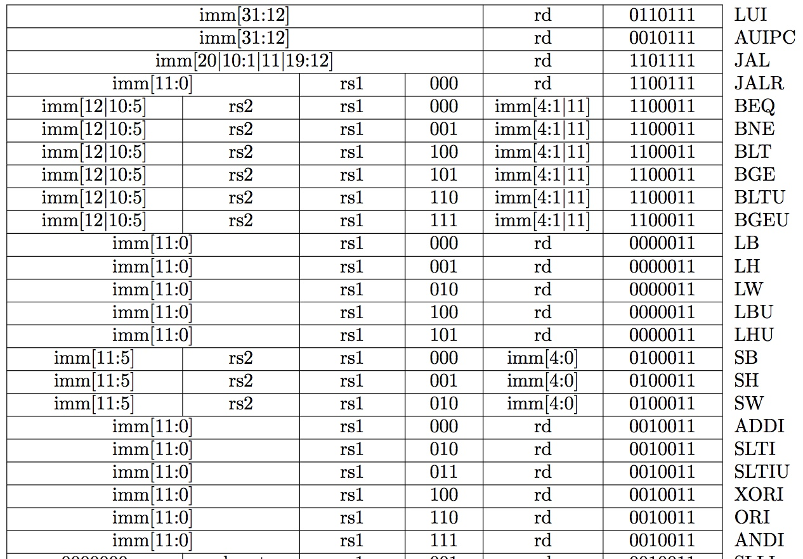
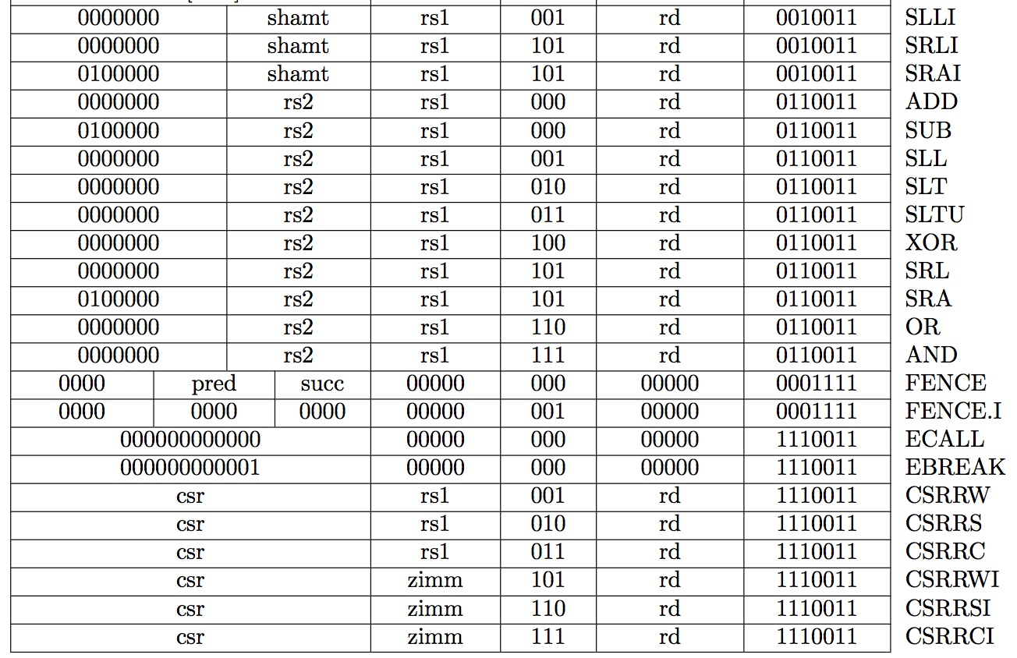
Recap: Complete RV32I ISA
Not Covered
RV32I has 47 instructions
37 instructions are enough to run any C program
CS61C Prof Dan Garcia and Miki Lustig, Univ of California, Berkeley

Slide 19
We have designed complete RV32I Datapath! Congratulations!!
+4
Add
Add
wb
pc
pc+4
2
DataD
Reg[rs1]
alu
1
alu
1
Inst[11:7]
0
wb
PC
addr
AddrD
1
0
addr
Inst[19:15]
DataA
alu
DataR
inst
pc+4
inst
AddrA
Branch
Comp
0
+
addr
mem
Inst[24:20]
AddrB
DataB
ALU
clk
0
DataW
IMEM
IMEM
Reg [ ]
1
DMEM
Inst [31:7]
clk
Reg[rs2]
clk
Imm.
Gen
Imm[31:0]
PCSel
Inst[31:0]
ImmSel
RegWEn
BrUn
BrLT
Bsel
ALUSel
MemRW
WBSel
Control logic
Asel
Control logic
BrEq
CS61C Prof Dan Garcia and Miki Lustig, Univ of California, Berkeley

Slide 20
Single Cycle Datapath Summary
We have designed the complete datapath
Capable of executing all RISC-V instructions in one cycle each
Not all units (hardware) used by all instructions
5 Phases of execution
IF, ID, EX, MEM, WB
Not all instructions are active in all phases
Controller specifies how to execute instructions
CS61C Prof Dan Garcia and Miki Lustig, Univ of California, Berkeley

Slide 21
Design of Control logic

Slide 22
Control Logic
Processor
Enable?
Read/Write
Memory
Control
Program
Datapath
Address
PC
Bytes
Registers
Write Data
Arithmetic & Logic Unit
(ALU)
Data
Read Data
Processor-Memory Interface
CS61C Prof Dan Garcia and Miki Lustig, Univ of California, Berkeley

Slide 23
Single-Cycle RISC-V RV32I Datapath
+4
Reg[]
pc
pc+4
pc
wb
1
alu
alu
1
DataD
Reg[rs1]
ALU
DMEM
2
IMEM
inst[11:7]
AddrD
0
1
pc+4
0
Branch Comp.
Reg[rs2]
Addr
DataR
0
wb
inst[19:15]
AddrA
DataA
0
DataW
mem
inst[24:20]
AddrB
DataB
1
inst[31:7]
Imm.
Gen
imm[31:0]
Control Logic
PCSel
inst[31:0]
ImmSel
RegWEn
BrUn
BrEq
BrLT
BSel
ASel
ALUSel
MemRW
WBSel
CS61C Prof Dan Garcia and Miki Lustig, Univ of California, Berkeley

Slide 24
Our Control Bits
PCSel
Does this instruction change my control flow?
What is the address of my next instruction?
ImmSel
Does this instruction have/use an immediate?
If yes, what type of instruction is it? How is the immediate stored?
RegWEn
Does this instruction write to the destination register rd?
BrUn
Does this instruction do a branch? If so, is it unsigned or signed?
Ref: CS61C Morgan Reschenberg, Univ of California, Berkeley

Slide 25
Our Control Bits
BSel
Does this instruction operate on R[rs2] or an immediate?
ASel
Does this instruction operate on R[rs1] or PC?
ALUSel
What operation should we perform on the selected operands?
MemRW
Do we want to write to memory? Do we want to read from memory?
If we don’t care about the memory output, what should we do?
WBSel
Which value do we want to write back to rd?
If we aren’t writing back (RegWEn = 0) does this value matter?
Ref: CS61C Morgan Reschenberg, Univ of California, Berkeley

Slide 26

Let’s try to design PCsel
Consider three cases:
Regular (non-control) instructions
Branches
Jumps
You may assume PCSel = 0 → PC = PC + 4,
PCSel = 1 → PC = ALUout
For regular instructions, PCSel is always 0, so our circuit looks like this
Ref: CS61C Morgan Reschenberg, Univ of California, Berkeley

Slide 27
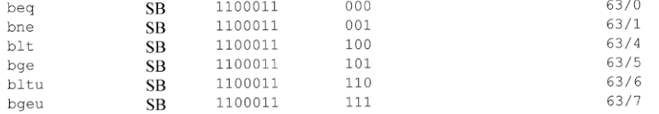
PCSel: Branch Instructions
How do we know if an instruction is a branch?
Check the green sheet (Instruction list)
In order: opcode, func3
They all have the same opcode! We should also check to make sure no other instructions have the same one!
Ref: CS61C Morgan Reschenberg, Univ of California, Berkeley

Slide 28
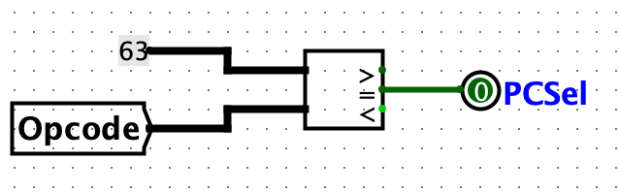
PCSel: Branch Instructions
Let’s describe the desired behaviour in words:
For a regular instruction, choose PC+4. For a branch instruction, choose ALUout
For a regular instruction, set PCSel = 0. For a branch instruction, set PCSel = 1
We can identify a branch instruction by doing an equality check on the opcode. Here’s our sub circuit:
Ref: CS61C Morgan Reschenberg, Univ of California, Berkeley

Slide 29
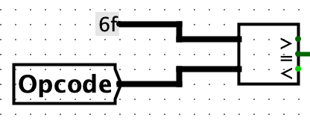
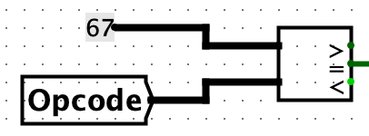
PCSel: Jumps
Which instructions are our jump instructions?
They are different, so no easy generalization
Same as with branching, though, we can do an equality check on the opcode using a comparator. We’ll have to do two separate comparisons here
Ref: CS61C Morgan Reschenberg, Univ of California, Berkeley

Slide 30
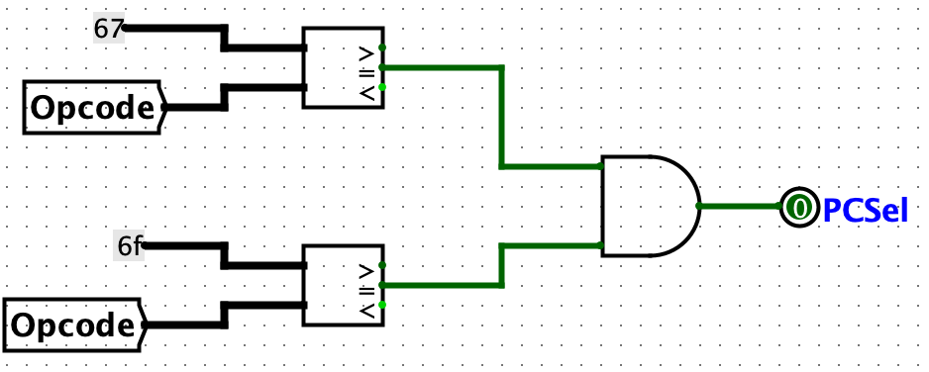
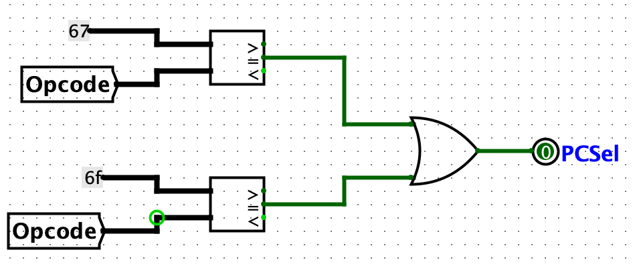
Trivia
Which of the following circuits is the correct PCSel for jumps?
A
B
Ref: CS61C Morgan Reschenberg, Univ of California, Berkeley

Slide 31
Putting them all together
Three cases
Regular instruction, or
Branch instruction, or
Jump instruction.
To combine all our signals together and retain the functionality of each individual piece, we’ll OR them
If any of the sub-circuits are true, PCSel will become 1
Otherwise, it’ll be 0
For all normal instructions will have PCSel = 0, while branch, jump will have PCSel = 1 as desired
Ref: CS61C Morgan Reschenberg, Univ of California, Berkeley

Slide 32
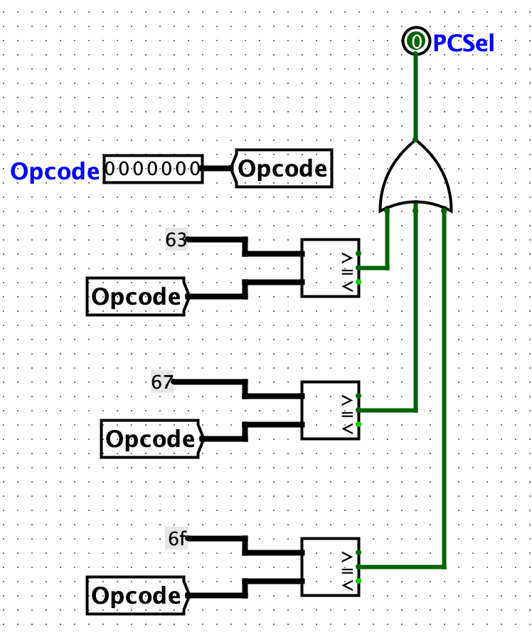
PCSel: Final Circuit
Ref: CS61C Morgan Reschenberg, Univ of California, Berkeley

Slide 33
Control Signals: Big picture
Control signals cause the same hardware to behave differently and execute different instructions
For every instruction, all control signals are set to one of their possible values or an indeterminate (*) value indicating the control signal doesn’t affect the instruction’s execution
Each control signal has a sub-circuit based on ~nine bits from the instruction format
We will see what are these bits..
Ref: CS61C Morgan Reschenberg, Univ of California, Berkeley

Slide 34
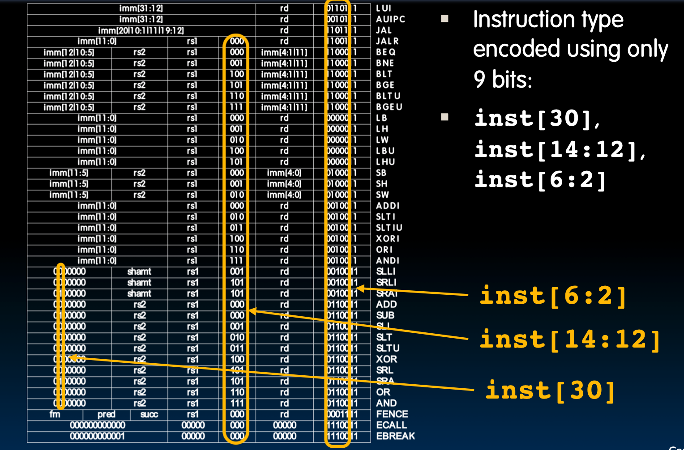
We need just 9 bits !

Slide 35
Control Signals: ADD
+4
Reg[]
pc
pc+4
pc
wb
1
alu
1
DataD
Reg[rs1]
ALU
2
alu
0
DMEM
0
IMEM
inst[11:7]
AddrD
Addr
1
pc+4
Branch Comp.
Reg[rs2]
DataR
wb
inst[19:15]
AddrA
DataA
0
0
DataW
mem
inst[24:20]
AddrB
DataB
1
inst[31:7]
Imm.
Gen
imm[31:0]
PCSel
inst[31:0]
ImmSel
RegWEn
BrUn
BrEq
BrLT
BSel
ASel
ALUSel
MemRW
WBSel

Slide 36
Class Summary
RISC-V instructions are very simple and regular → simple datapath design
We have studied single cycle datapath for
R-type Instructions
I-type Instructions
Branch Instructions
Jump Instructions
U–type Instructions

